Slide 1



Summer Update
Osmani Primary School
28th February – 19th June 2026
The Team
Child Therapist | Clare Spronk
Child Therapist | Zoe Weston
UP Trainee Therapist | Katie Willmore
UP Trainee Therapist | Stephanie Canlas
A look back on this year with UP
As we approach the end of the academic year and enter what is often the busiest school term, children, families, and staff are preparing for change and transition. While transitions can bring uncertainty and challenge, they also create opportunities for growth, resilience, and new beginnings.
This theme has also been reflected within our therapeutic service this year as we introduced our new intervention model and welcomed new team members. Through these changes, we have continued to provide high-quality MDT support, including short- and long-term therapy, OT and SALT provision, wellbeing check-ins, and Speak Up sessions, parent support and others.
Working in partnership with school staff and families, we have identified and supported children who would benefit from therapeutic intervention, ensuring they receive the right support at the right time.
Our team is grateful to the school community for its warm welcome and ongoing partnership. Staff have consistently commented on how everyone in the school has strong commitment to children's wellbeing and is dedicated to supporting every child to thrive.
I like coming here, it's too fun!
I will miss (6xTT) will you come back?
Year 3 & 6xTT
Breakdown by Numbers
12
Children seen for
1:1 Therapy
15
Speak Up sessions
118
1:1 Therapy
sessions offered
6
Children seen for SALT
2
Children seen for 6xTalkTime
24
SALT sessions offered
8
6xTalk Time sessions offered
3
Children in Wellbeing Group
3
Children seen for Check-ins
10
Teacher Meetings attended
A space like this helps me to express my feelings and that helps me.
Year 6 & Speak Ups
14
Check-In session offered
11
Parent Meetings attended
www.up.org.uk 07387 108743 Canopi, 82 Tanner Street, London, SE1 3GN Registered Charity No. 1163932

Slide 2
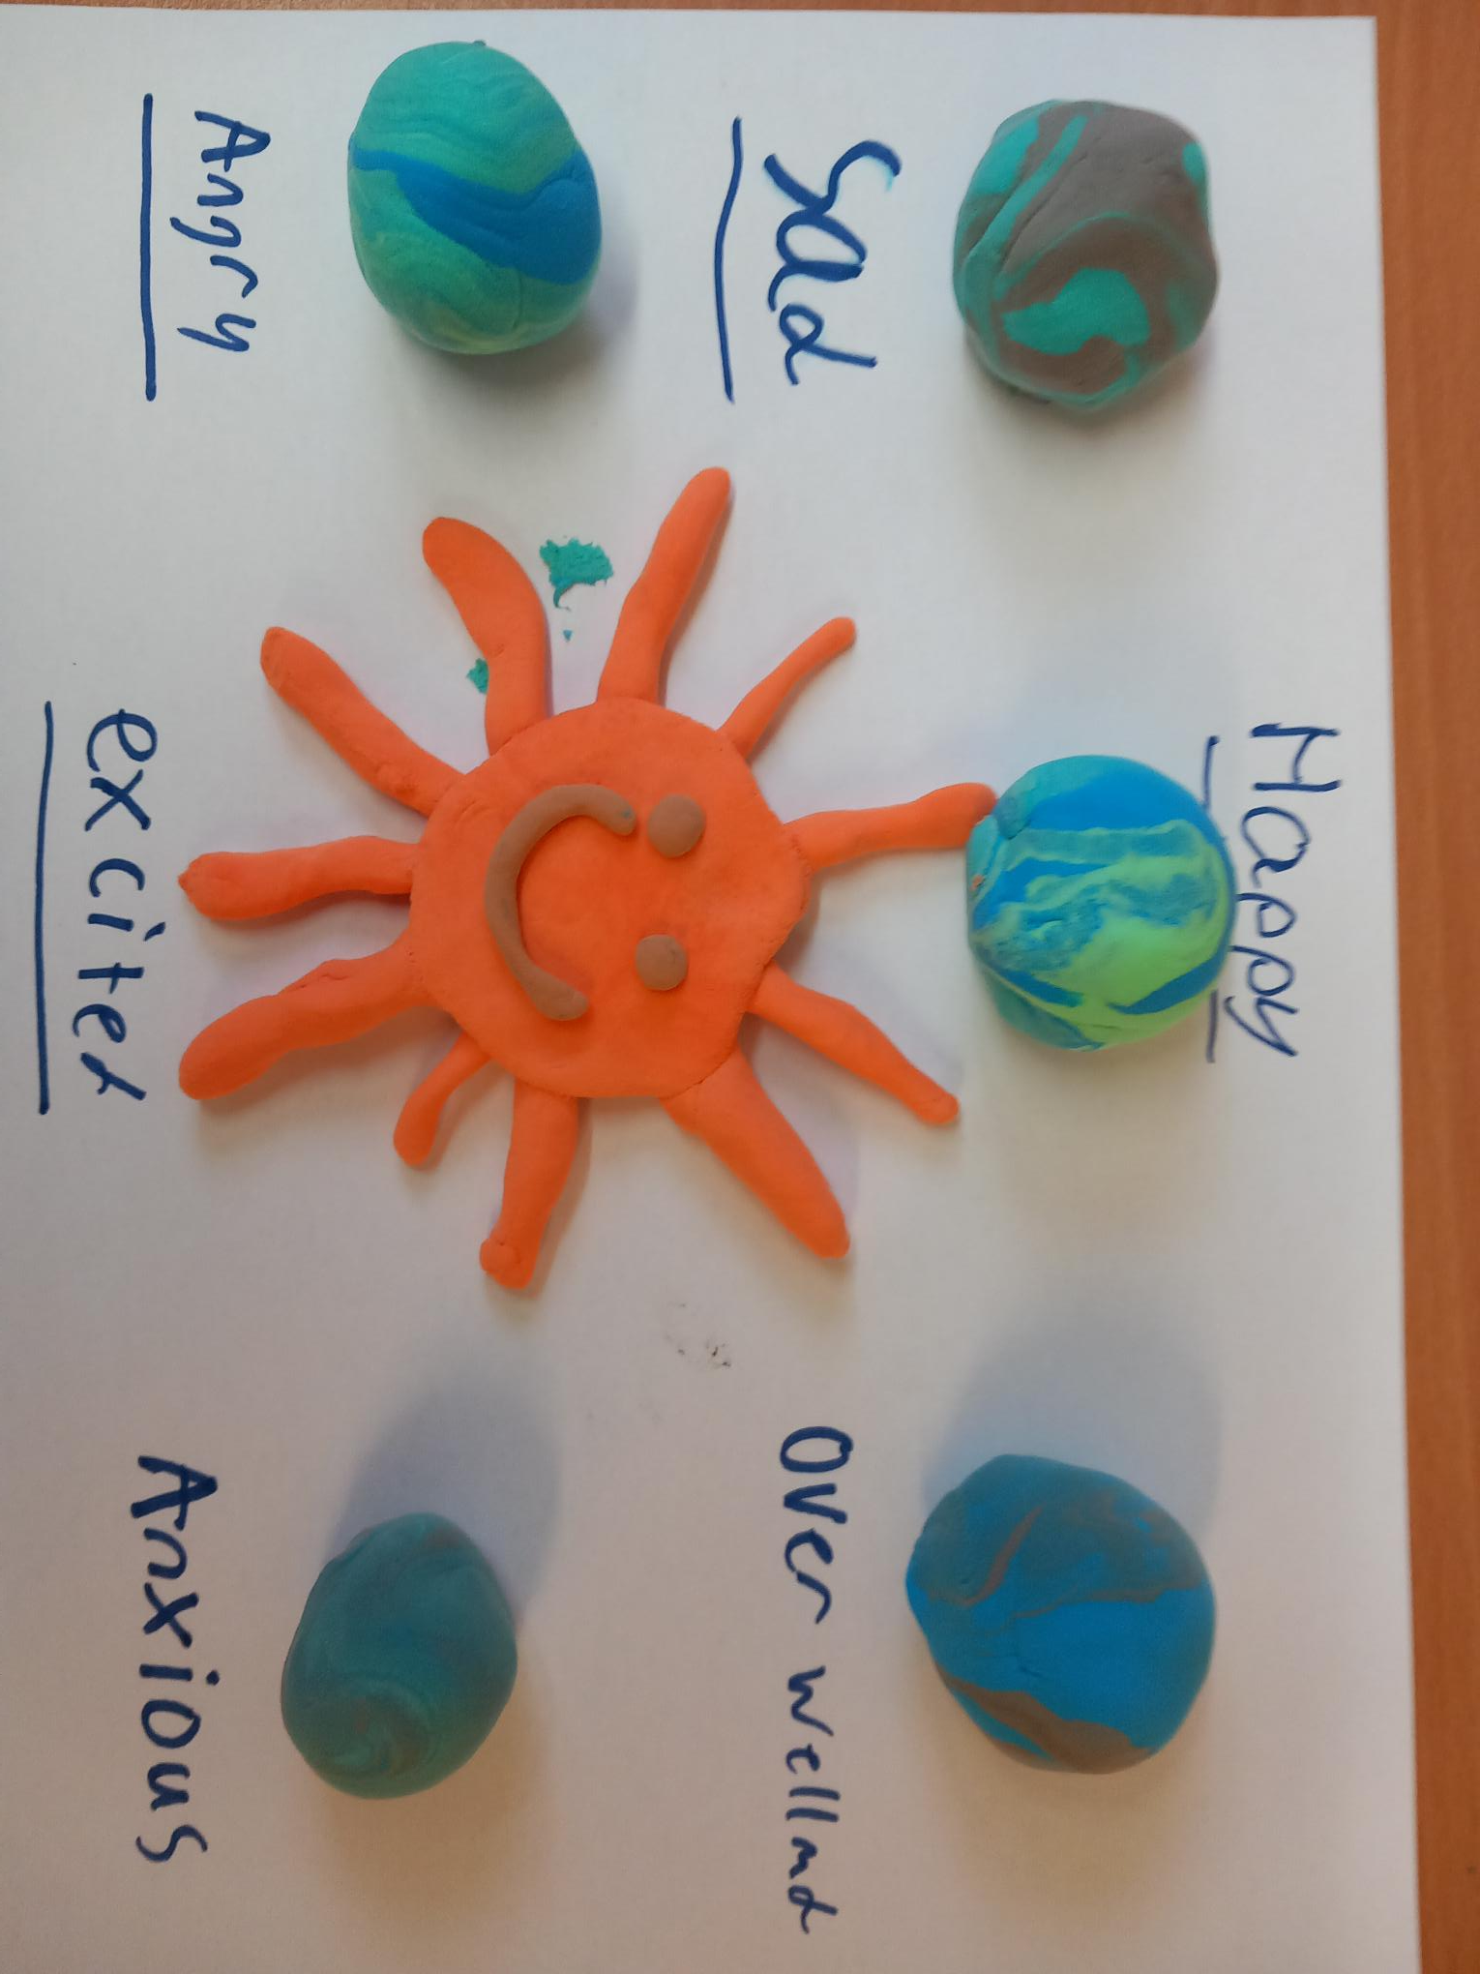
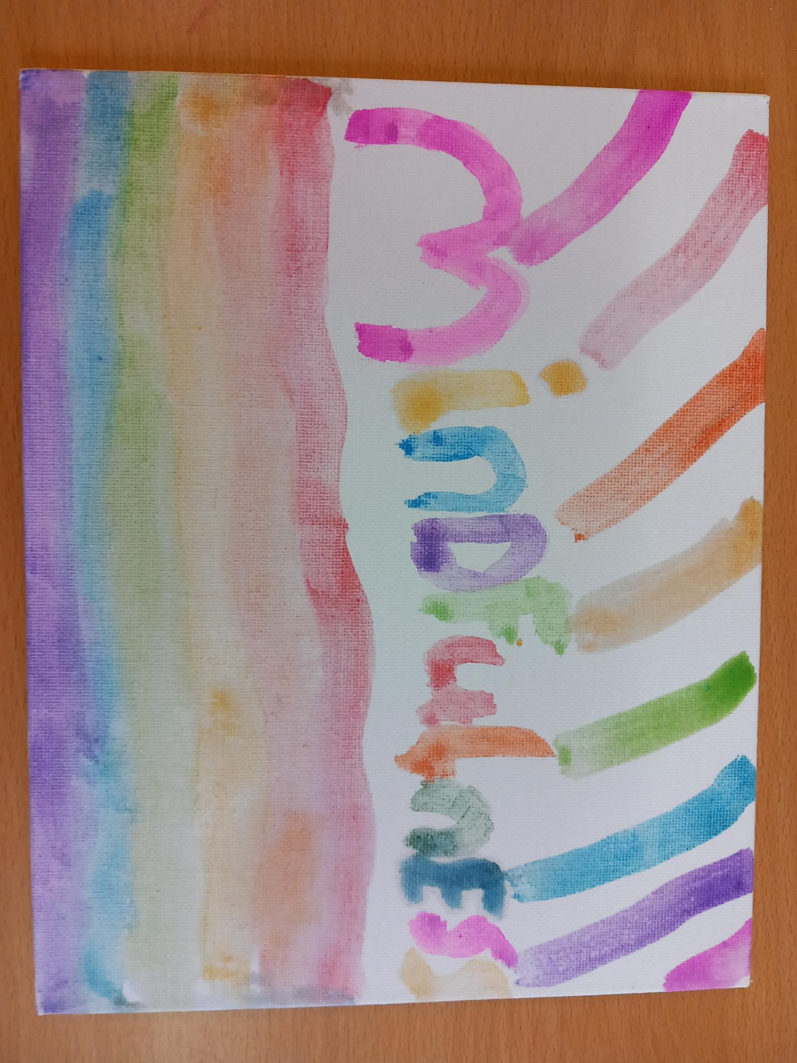
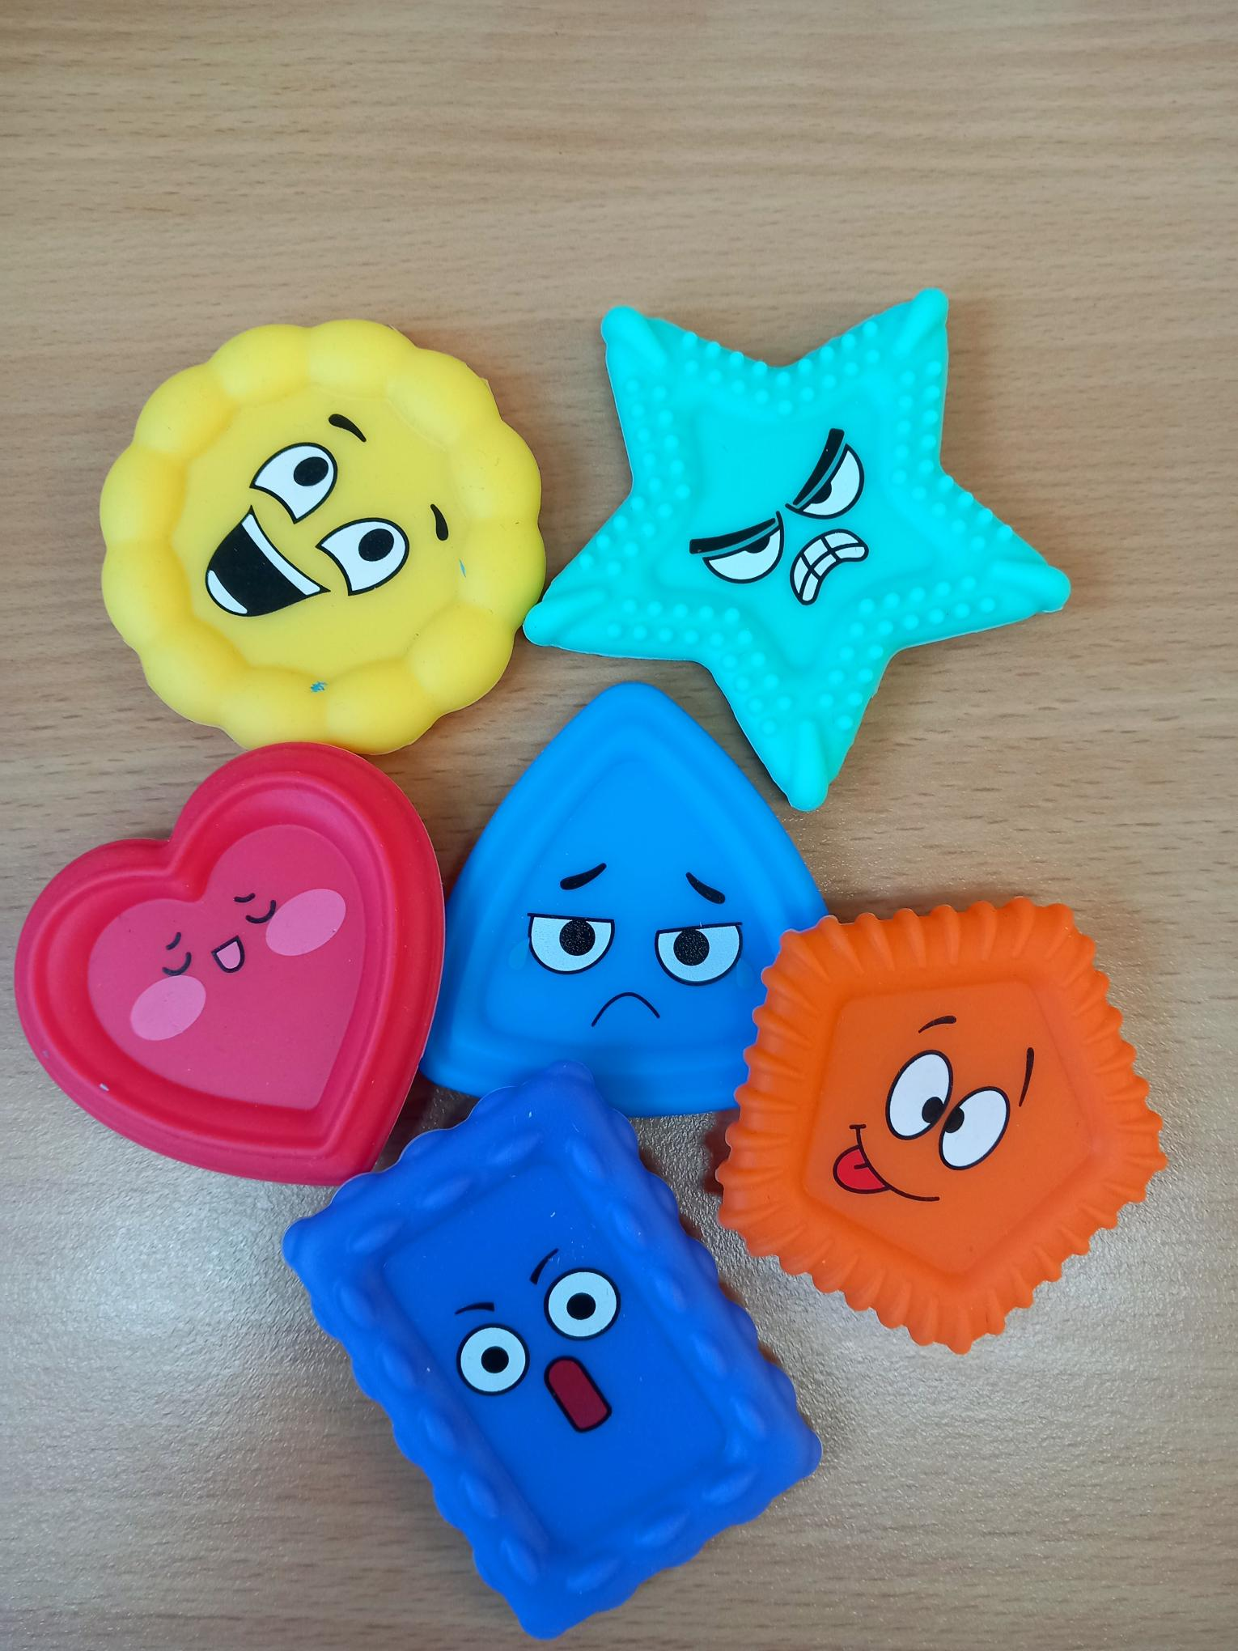
1:1 Therapy
This term, our two trainee therapists and two child therapists have provided 1:1 therapeutic support to 12 children, working with a range of needs from low to high complexity. The intervention provides a safe, supportive space where children can explore their thoughts, feelings, and experiences using age-appropriate and creative approaches, including play, art, and sensory resources within a well-resourced therapy room. Therapists work sensitively with a range of emotional, behavioural, and relational difficulties, helping children build resilience and develop healthier ways of coping. Where beneficial, therapists also work closely with teachers and parents/carers, within the limits of confidentiality, to ensure children receive consistent support across home and school environments.
6 x Talk Time
This is another therapeutic intervention, offering children a focused six-week programme tailored to specific emotional, behavioural or social challenges. Through consistent weekly sessions, a positive therapeutic working alliance and strong rapport can be established, creating a safe and trusting environment for the child. This approach provides opportunities for more direct and targeted therapeutic work, enabling children to explore their thoughts, feelings and experiences, develop coping strategies, build resilience, and work towards agreed goals. The structured nature of the intervention allows progress to be monitored and reviewed, helping children gain confidence, improve emotional wellbeing, and develop skills that can support them beyond the therapeutic setting.
Check ins and Speak Ups
The Check-In and Speak-Up provision has been well utilised throughout the school, supporting children with a range of needs including friendship difficulties, anxiety, emotional regulation, bereavement, family changes and school-based worries. Check-Ins, requested by teachers or parents, provided a flexible and timely intervention for children requiring additional support. Speak-Ups offered a self-referral opportunity during break and lunchtime periods, allowing children to independently access support from the child therapist when needed. Together, these provisions created a responsive and nurturing service, helping children feel heard, supported and empowered while enabling concerns to be addressed at an early stage.

